Slide 1

Computer science and information technology department

Slide 2

SKILL DEVELOPMENT PROJECT
Submitted By:-SHASWAT KUMAR (1802911048)
RAJAT KUMAR (1802911035)

Slide 3
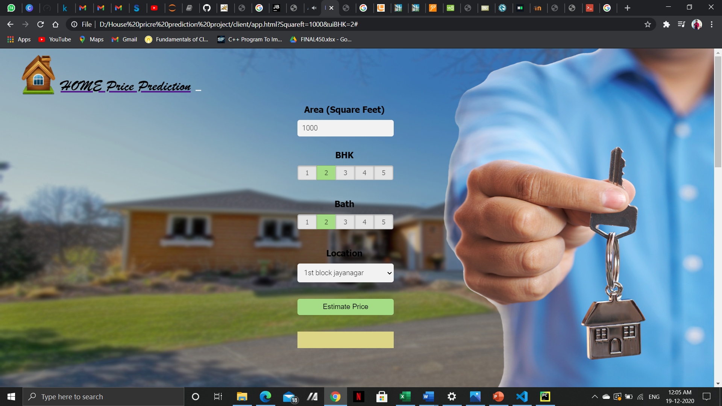
HOME PRICE Prediction using LINEAR REGRESSION

Slide 4
INTRODUCTION
Investment is a business activity on which most people are interested in this globalization era.
In particular, property investment has increased significantly. Housing price trends are not only the concern of buyers and sellers, but it also indicates the current economic situation.

Slide 5
LANGUAGE USED
JAVASCRIPT
PYTHON
HTML
CSS

Slide 6
Motivation and Objective of project
Manual house predication becomes difficult, hence there are many systems developed for house price prediction
We proposed an advanced house prediction system using linear regression
This system aim is to make a model which can give us a good house pricing prediction based on other variables.
We are going to use Linear Regression for this dataset and hence it gives a good accuracy.

Slide 7
FLOW Process
Data Cleaning
Featuring Engineering
Outliner Removal
Model Building Using linear regression
Building
UI
Creating Python Flask Server

Slide 8
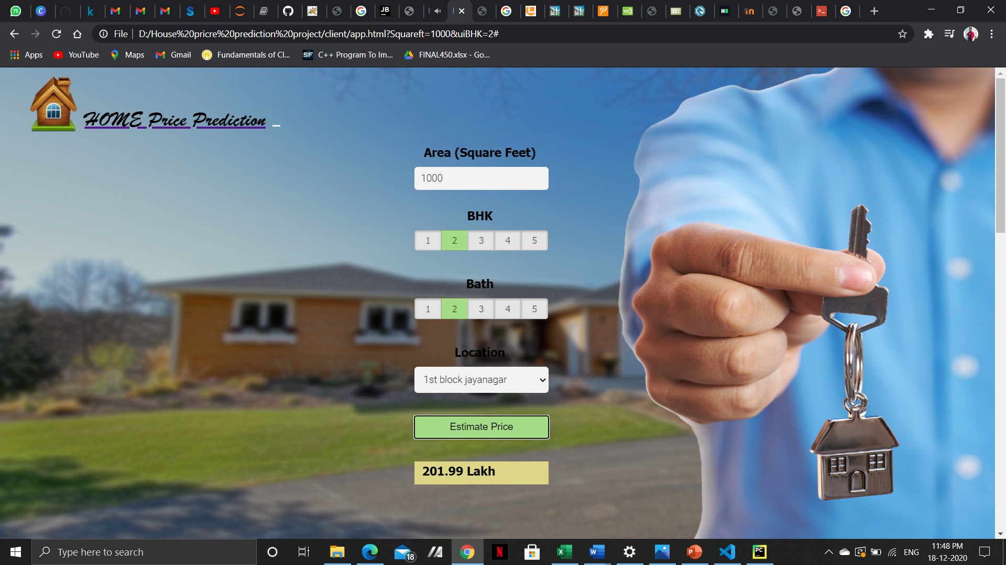

EXPERIMENTAL RESULTS

Slide 9



Slide 10
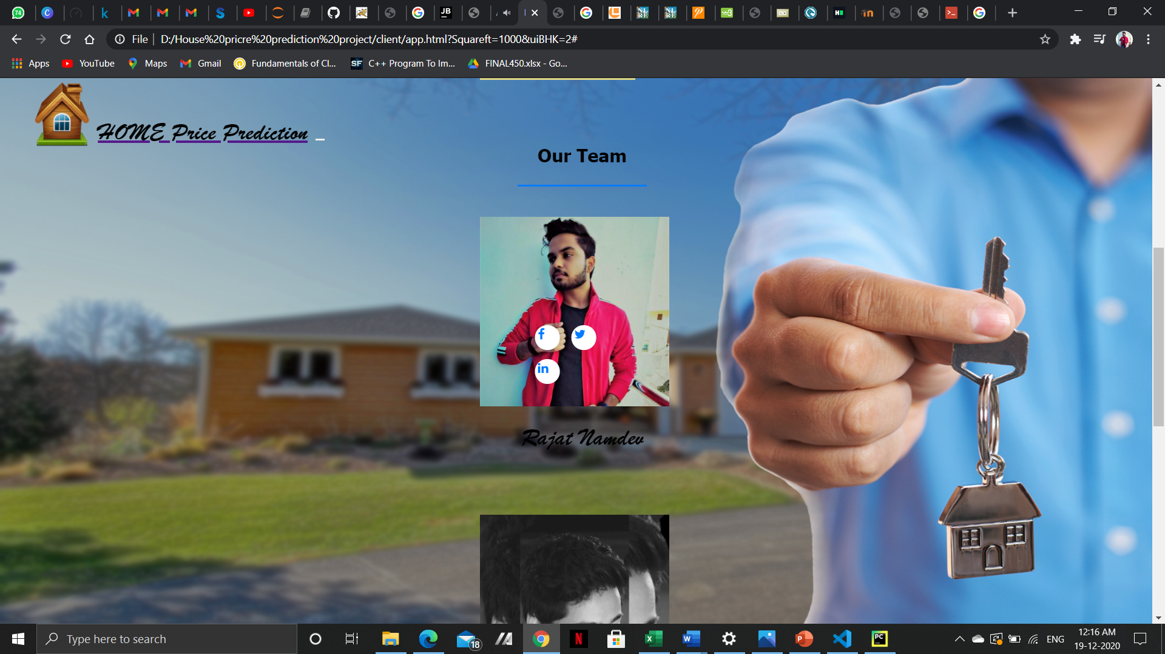
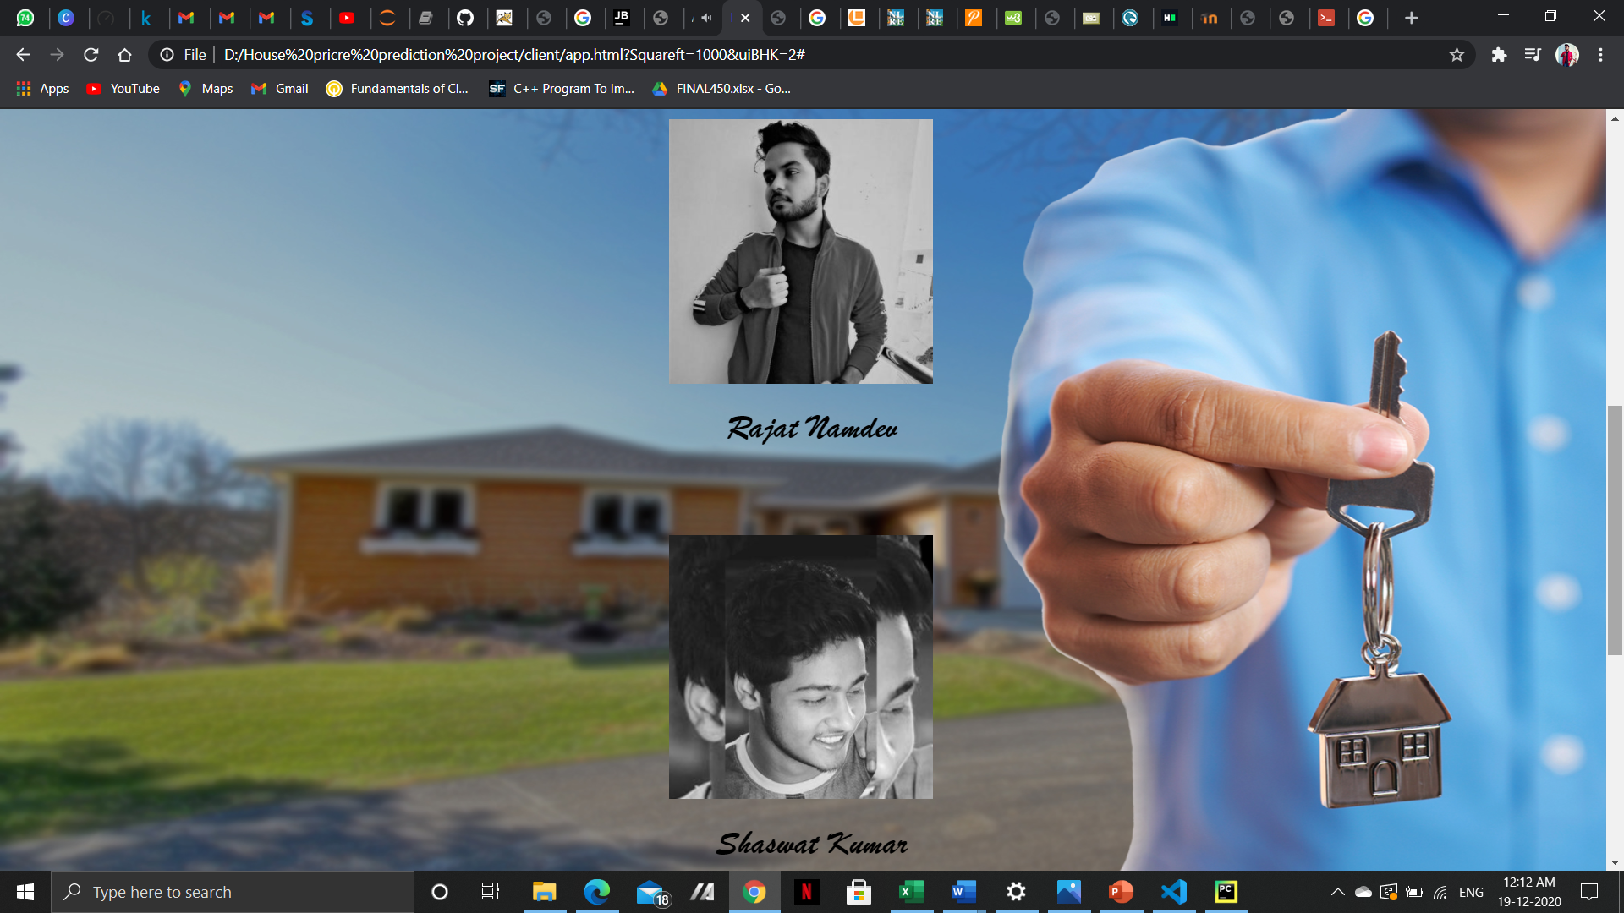
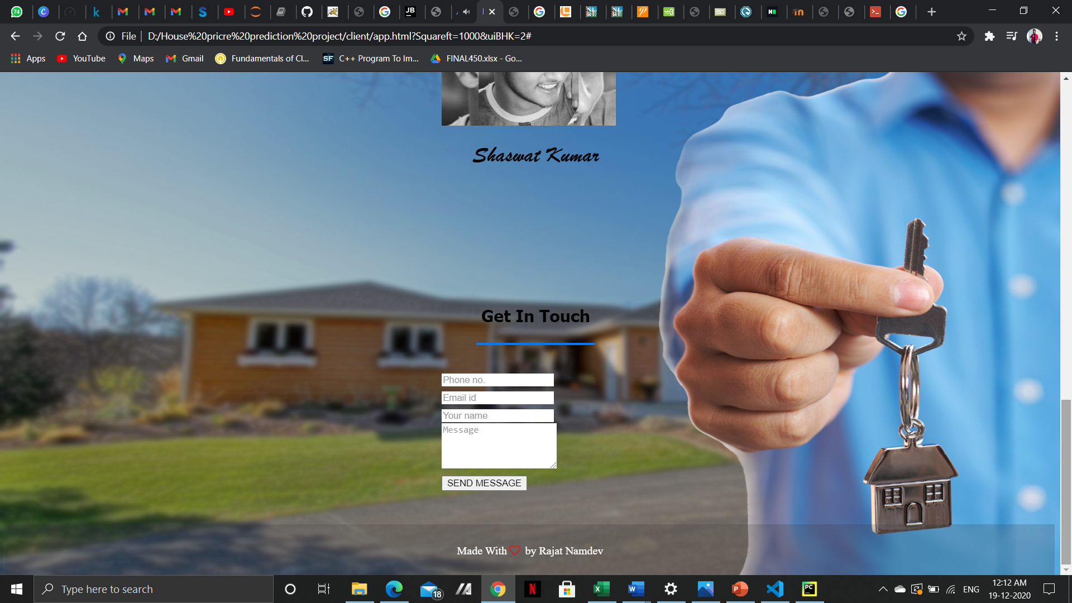
FINAL LOOK

Slide 11
Conclusion
In today’s real estate world, it has become tough to store such huge data and extract them for one’s own requirement. Also, the extracted data should be useful. The system makes optimal use of the Linear Regression Algorithm. The system makes use of such data in the most efficient way. The linear regression algorithm helps to fulfill customers by increasing the accuracy of estate choice and reducing the risk of investing in an estate. A lot’s of features that could be added to make the system more widely acceptable. One of the major future scopes is adding estate database of more cities which will provide the user to explore more estates and reach an accurate decision.

Slide 12
References
https://www.kaggle.com
https://towardsdatascience.com
https://www.edureka.co/blog/linear-regression-for-machine-learning

Slide 13
WEBSITE IN UNDER PROCESS 1. TO MODIFY & 2. NEW FEATURES

Slide 14

THANK YOU

